Slide 1
immedia studio: Bot Framework
Pivendren Naik
Pivendren Naik

Slide 2
Agenda Session 1 – Bot framework overview and basic bot Session 2 – Getting info from a user Session 3 – Making your bot smart with external APIs Session 4 – Say hi to LUIS Session 5 – Still chatting to LUIS

Slide 3
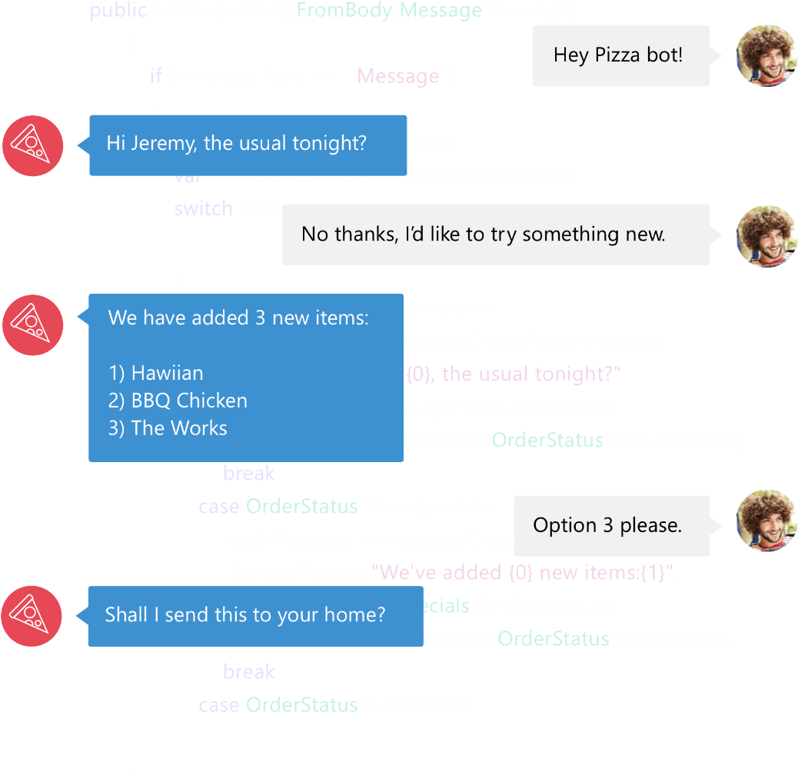

Bot Framework
Bot Framework is a Microsoft-operated service and an SDK.
Bot Framework is one of many tools Microsoft offers for building a complete bot.
Others include: LUIS, Speech APIs, Azure, more
www.botframework.com

Slide 4
Your bot
Logic
Your conversation logic
Bot Builder SDK (Node.js + C#)
Web service
LUIS

Slide 5
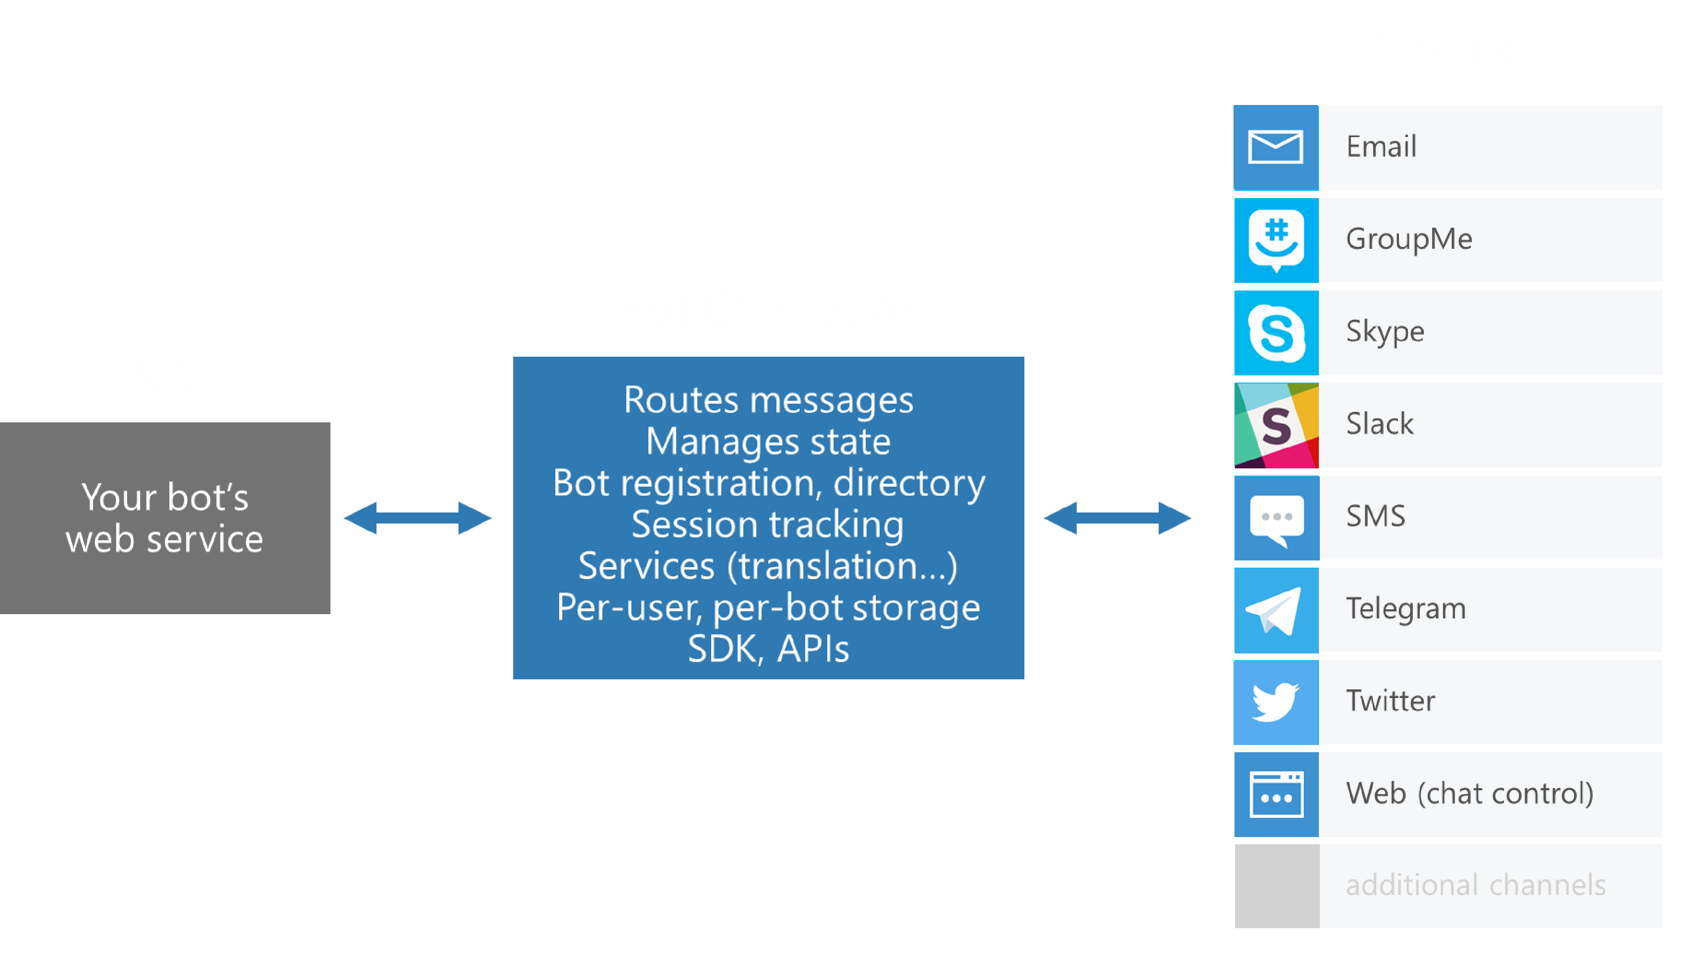
Bot Connector
Dev portal
Bot Connector
Send/receive messages
Store state
Translation
Telemetry
…
Your bot

Slide 6
Bot Connector messages
Your bot
Bot Connector
{
"type": "Message",
"id": "68YrxgtB53Y",
"conversationId": "DphPaFQrDuZDKyCez4AFGcT4vy5aQDje1lLGIjB8v18MFtb",
"language": "en",
"text": "You can say \"/order\" to order!",
"attachments": [ ],
"from": {
"name": "+12065551212",
"channelId": "sms",
"address": "+12065551212",
"id": "Ro52hKN287",
"isBot": false
},
"channelData": { SMS data here },
"botUserData": { your data here },
...
}

Slide 7
Stay Connected
Twitter - @ErrorNaik Blog - www.errornaik.com

